Slide 1
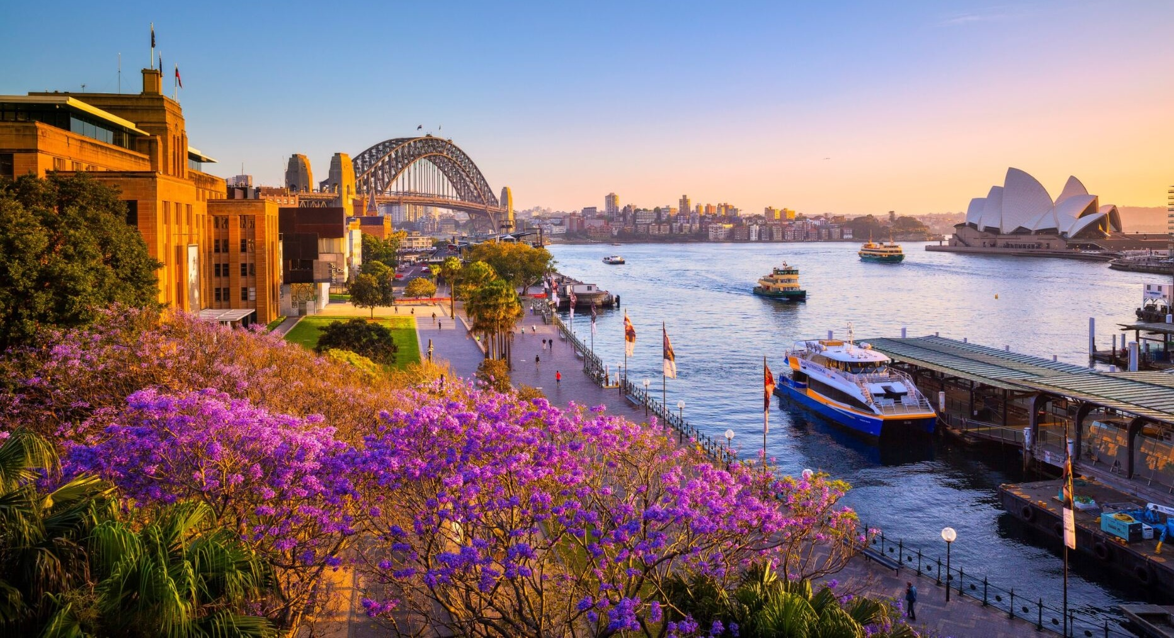
Join us in Sydney
<< EVENT NAME & LOGO >>

Slide 2
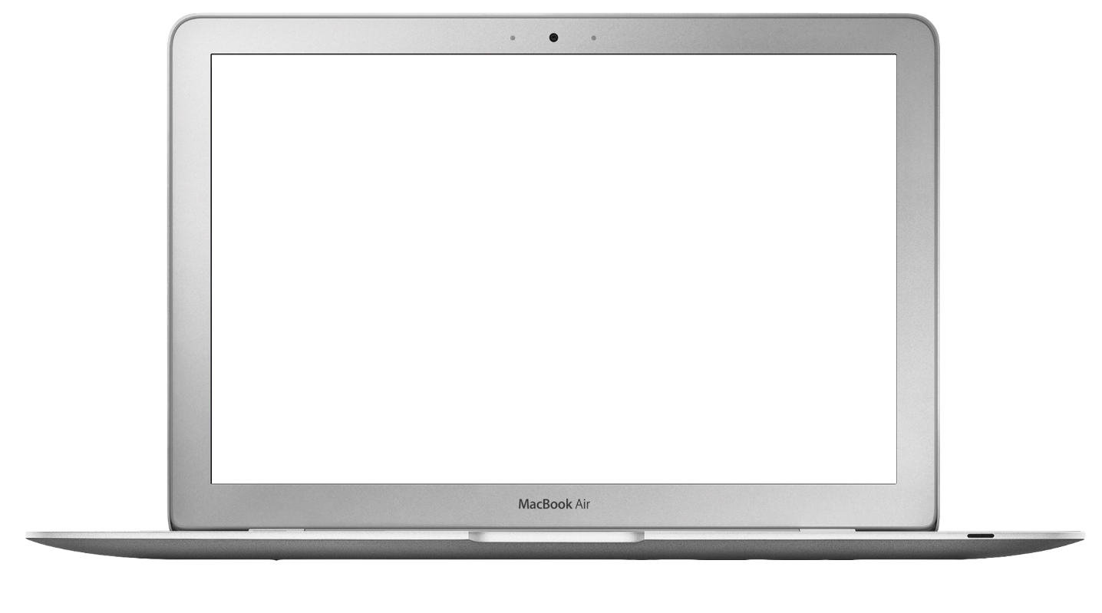
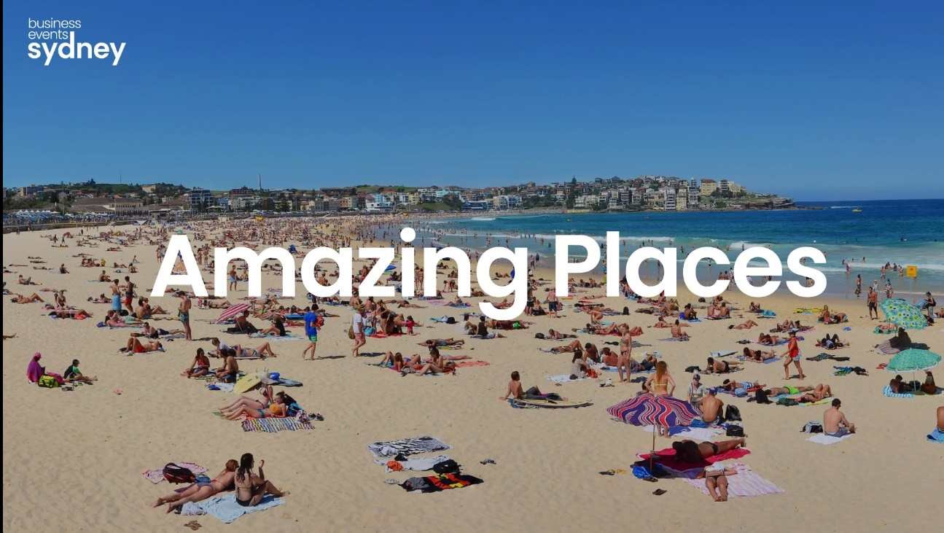

Sydney
The perfect place to connect, reward and inspire.
hover & click

Slide 3
Proposed General Chair / Sydney’s Bid Leader
[Name, credentials, affiliations]
[bio / conference hosting credentials]
Notes:
Click on the icon on the right of the slide to select the required head shot image from your desktop.

Slide 4
Local organising committee
We have assembled and internationally recognised team of professionals who will bring exceptional depth and breadth in experience and connection in their respective fields.
[Name]
[Role for conference]
[Role/affiliation generally]
[Name]
[Role for conference]
[Role/affiliation generally]
[Name]
[Role for conference]
[Role/affiliation generally]
[Name]
[Role for conference]
[Role/affiliation generally]
[Name]
[Role for conference]
[Role/affiliation generally]
[Details/experience]
[Details/experience]
[Details/experience]
[Details/experience]
[Details/experience]
Notes:
Click on the icons to select the required head shot images from your desktop.

Slide 5
Local supporters and potential sponsors
Notes:
Insert logos for supporters of your bid by clicking the icons in the centre of the squares and selecting the required supporter logo from your desktop.

Slide 6











World renowned global city, APAC business hub
Voted International Festival & Events Association’s ‘World’s Best Festival And Event City’ for tenth year in a row (2019)
Sydney has a perfect average temperature all year round of 21.7c/71.06f
Strong MICE infrastructure (hotels and venues)
Multicultural melting pot
Iconic city and gateway of Australia
Ranked 5th in the world for safety, health and security*
Best of both worlds: City & Nature
Accessibility: huge network of flights from all over Asia
Innovation and knowledge hub
Wide variety of touring options for all taste and budgets
Strong track record of delivering successful events
Why Sydney?
* 2023 World Population Review
Notes:
Page 8 or Page 9??

Slide 7
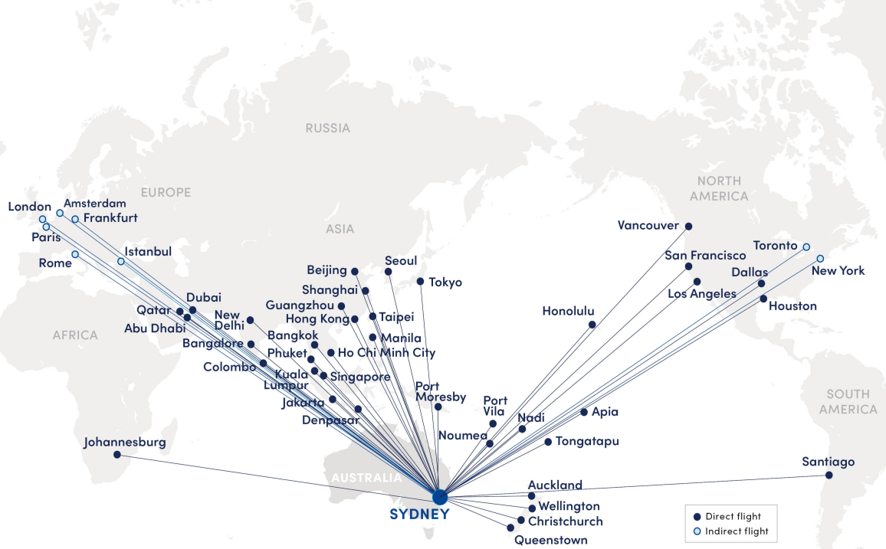


Getting to Sydney
630+ direct international flights per week*
Assistance with visa applications
13-minute train ride from Sydney Airport to city centre
Source: Bureau of Infrastructure, Transport and Regional Economics (BITRE), April 2023
This map is intended to be a graphical overview of a small portion of the flights connecting to Sydney. It does not cover all flights, and some flights may require a connection.

Slide 8
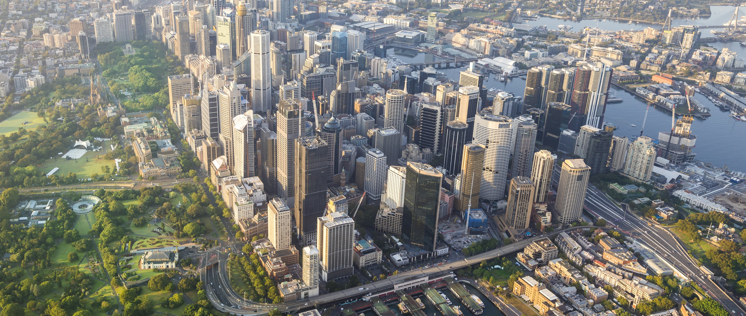
Fast transfers
Sydney Airport is only 8 kilometres from the city centre
Train
13 minutes
AUD18*
USD12
EUR11^
Taxi
20-25 minutes
AUD45-55*
USD30-27
EUR27-33^
(plus AUD5/USD3 airport toll)
Car rental
20-25 minutes
AUD60-75*
USD40-50
EUR24-30
(based on a 4-day rental of an economy car)
Shuttle
20-25 minutes
AUD30-35*
USD20-25
EUR12-15^
(plus AUD5/USD 3 airport toll)
* Includes 10% Australian Goods & Services Tax (GST).
^ Currency conversions for comparison purposes only; correct as at October 2023.

Slide 9
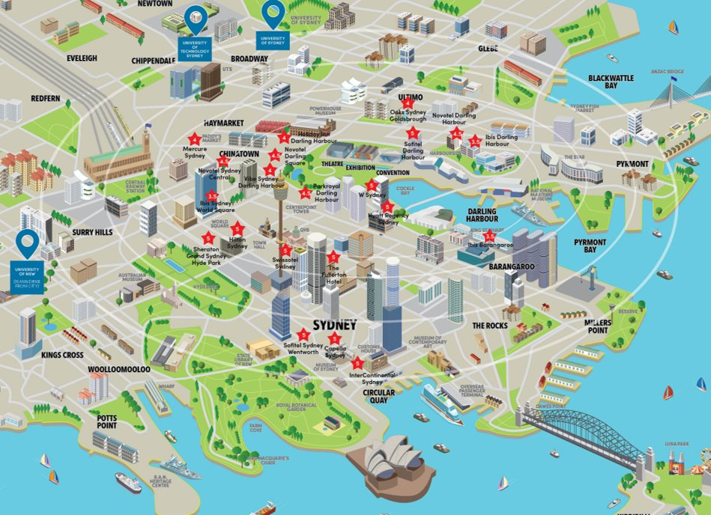




Accommodation
Sydney has over 46,000 hotel/motel rooms and serviced apartments with almost half located in the city centre within walking distance to major venues and attractions.
Most of the internationally renowned hotel groups are represented in Sydney and our four and five-star properties rival the best in the world.
Star rating | Approx. number of rooms
★ ★ ★ | 762
★ ★ ★ ★ | 2,208
★ ★ ★ ★ | 4,912
★ ★ ★ ★ ★ | 4,349
★ ★ ★ ★ ★ | 9,694
46,000+ hotel rooms and serviced apartments
9,000+ hotel rooms only 15-min walk to Darling Harbour
1,000+ budget rooms only 20-min walk to Darling Harbour
10-min walk
15-min walk
20-min walk
30-min walk
[Proposed venue name]
Notes:
The Legend box can be edited as required.
Overwrite the venue name text and move the red venue marker onto the map to highlight location of your conference venue.

Slide 10
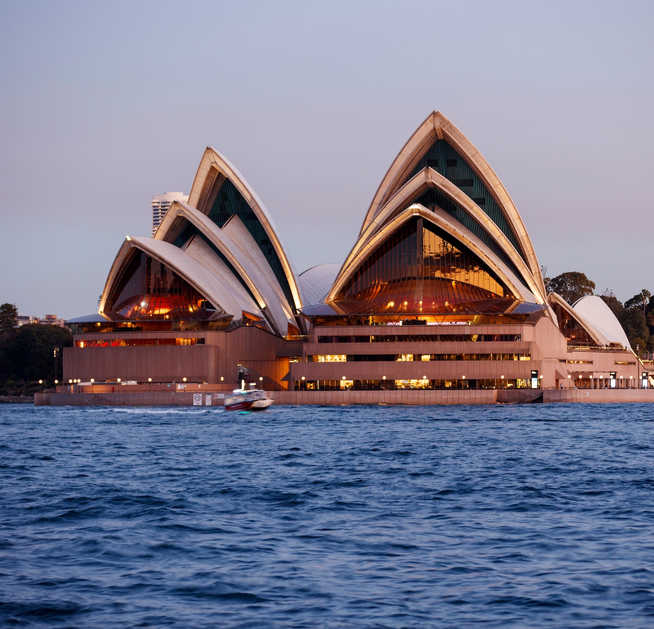
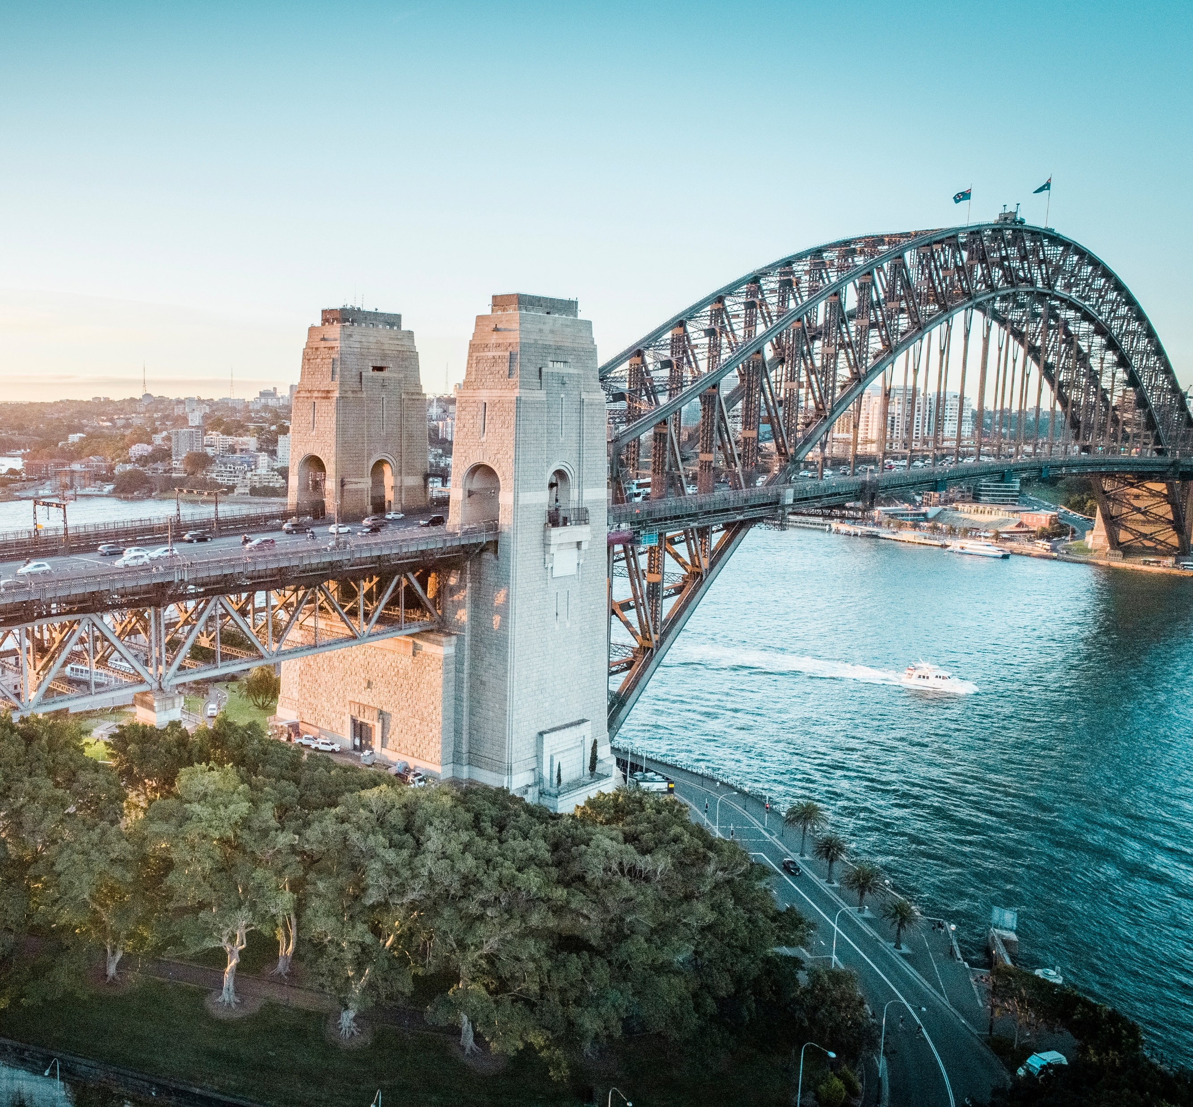
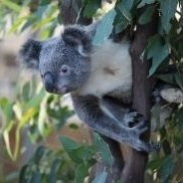
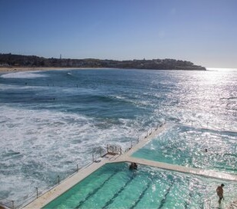
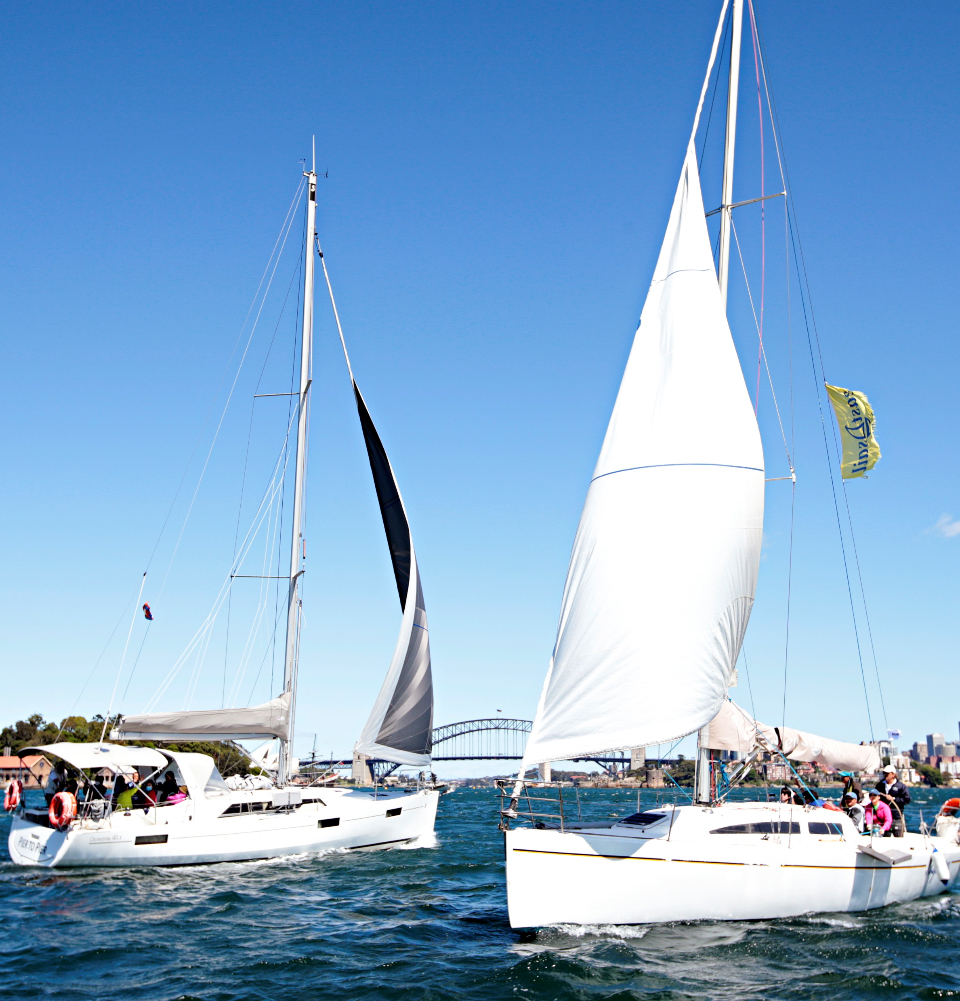
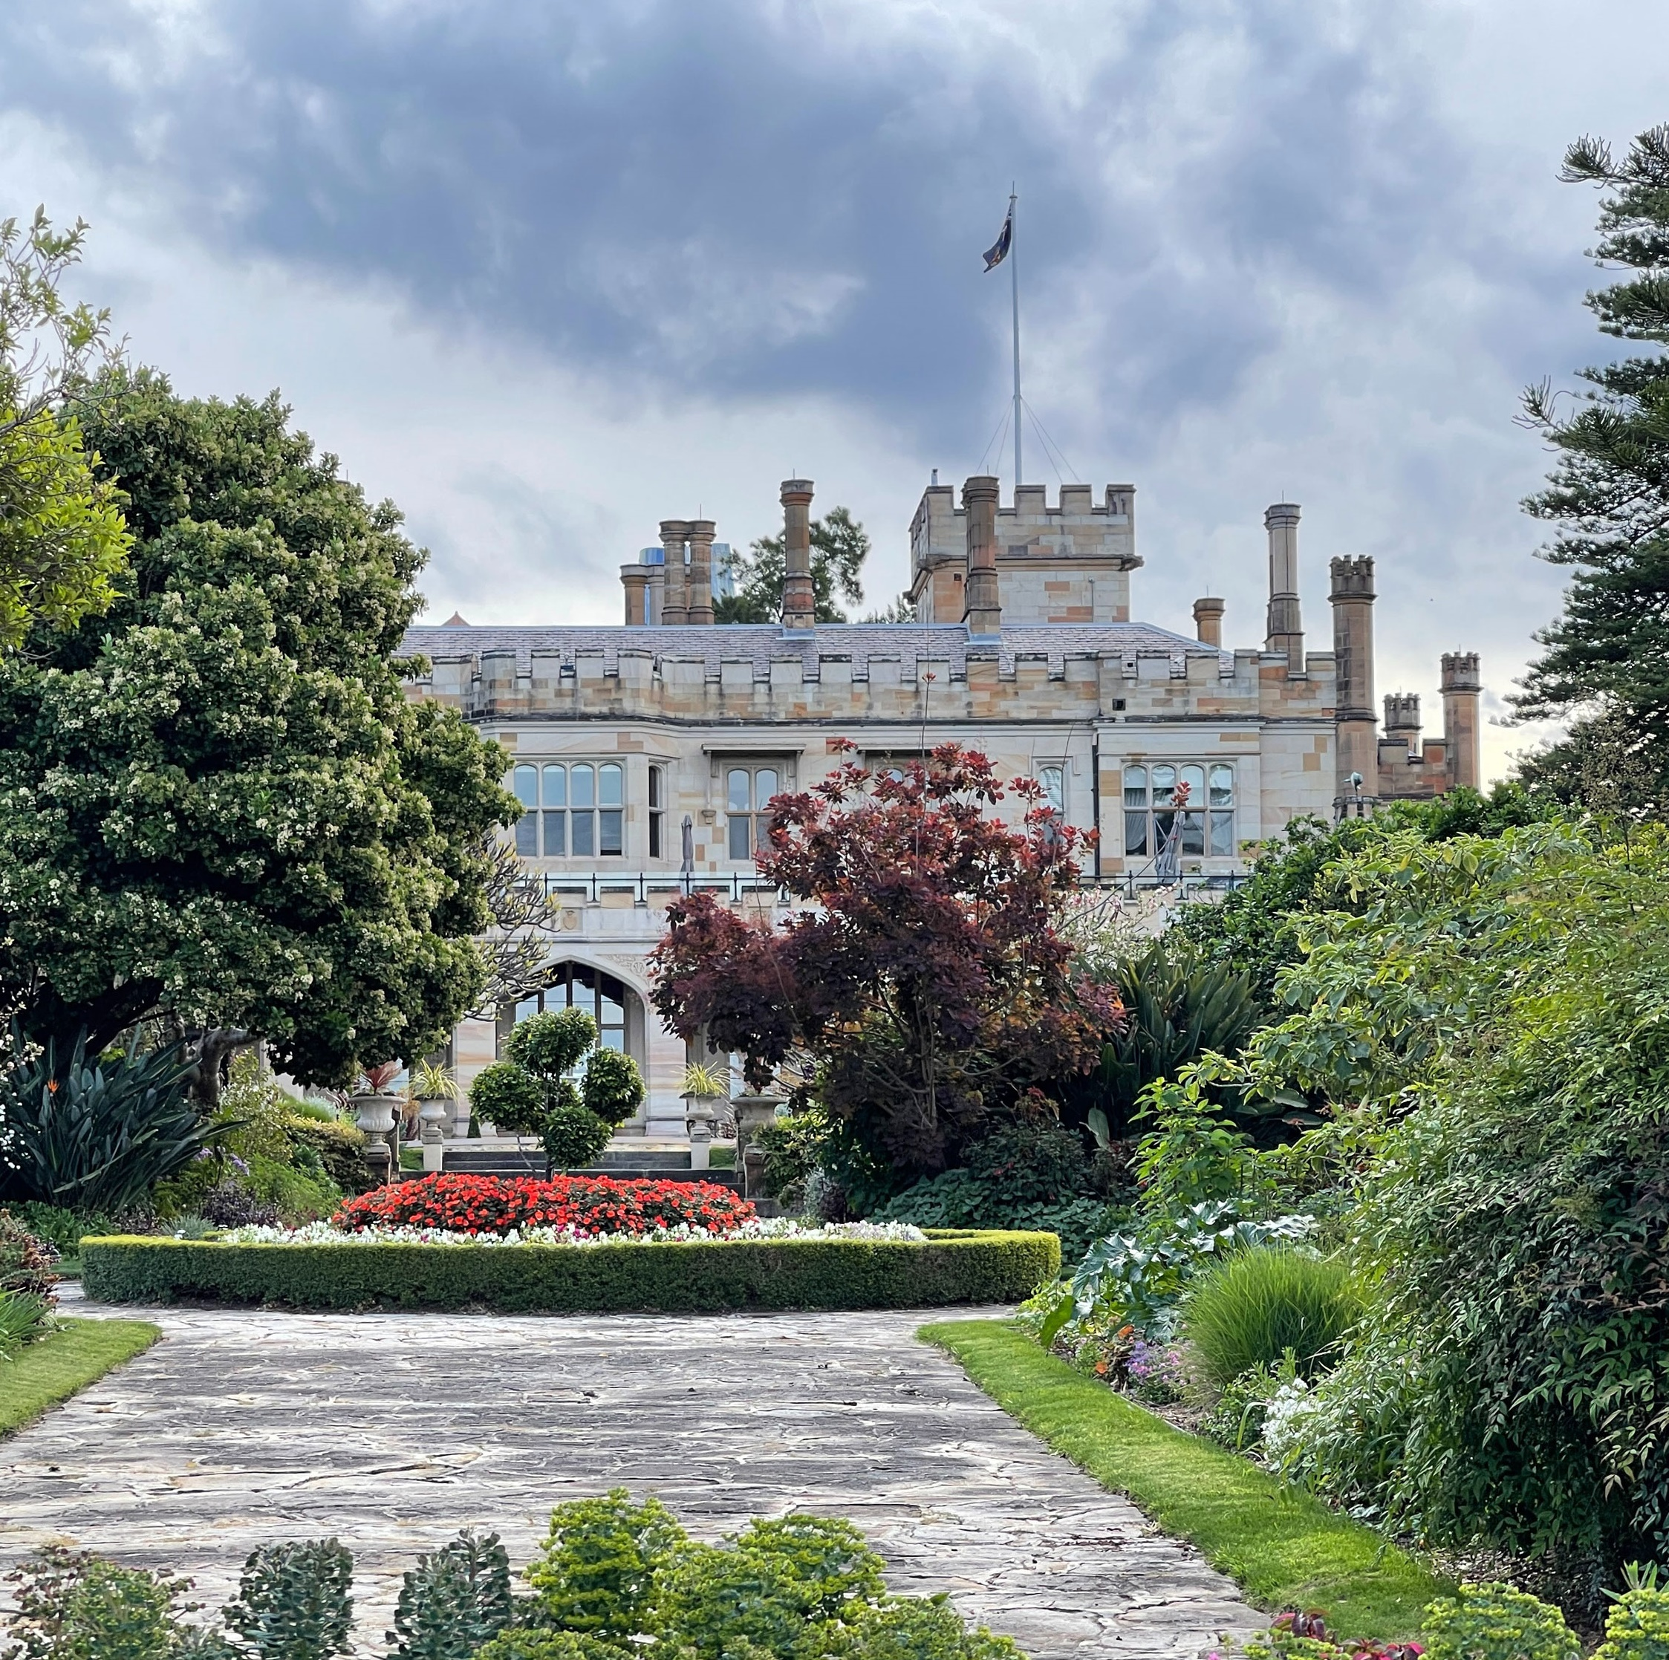
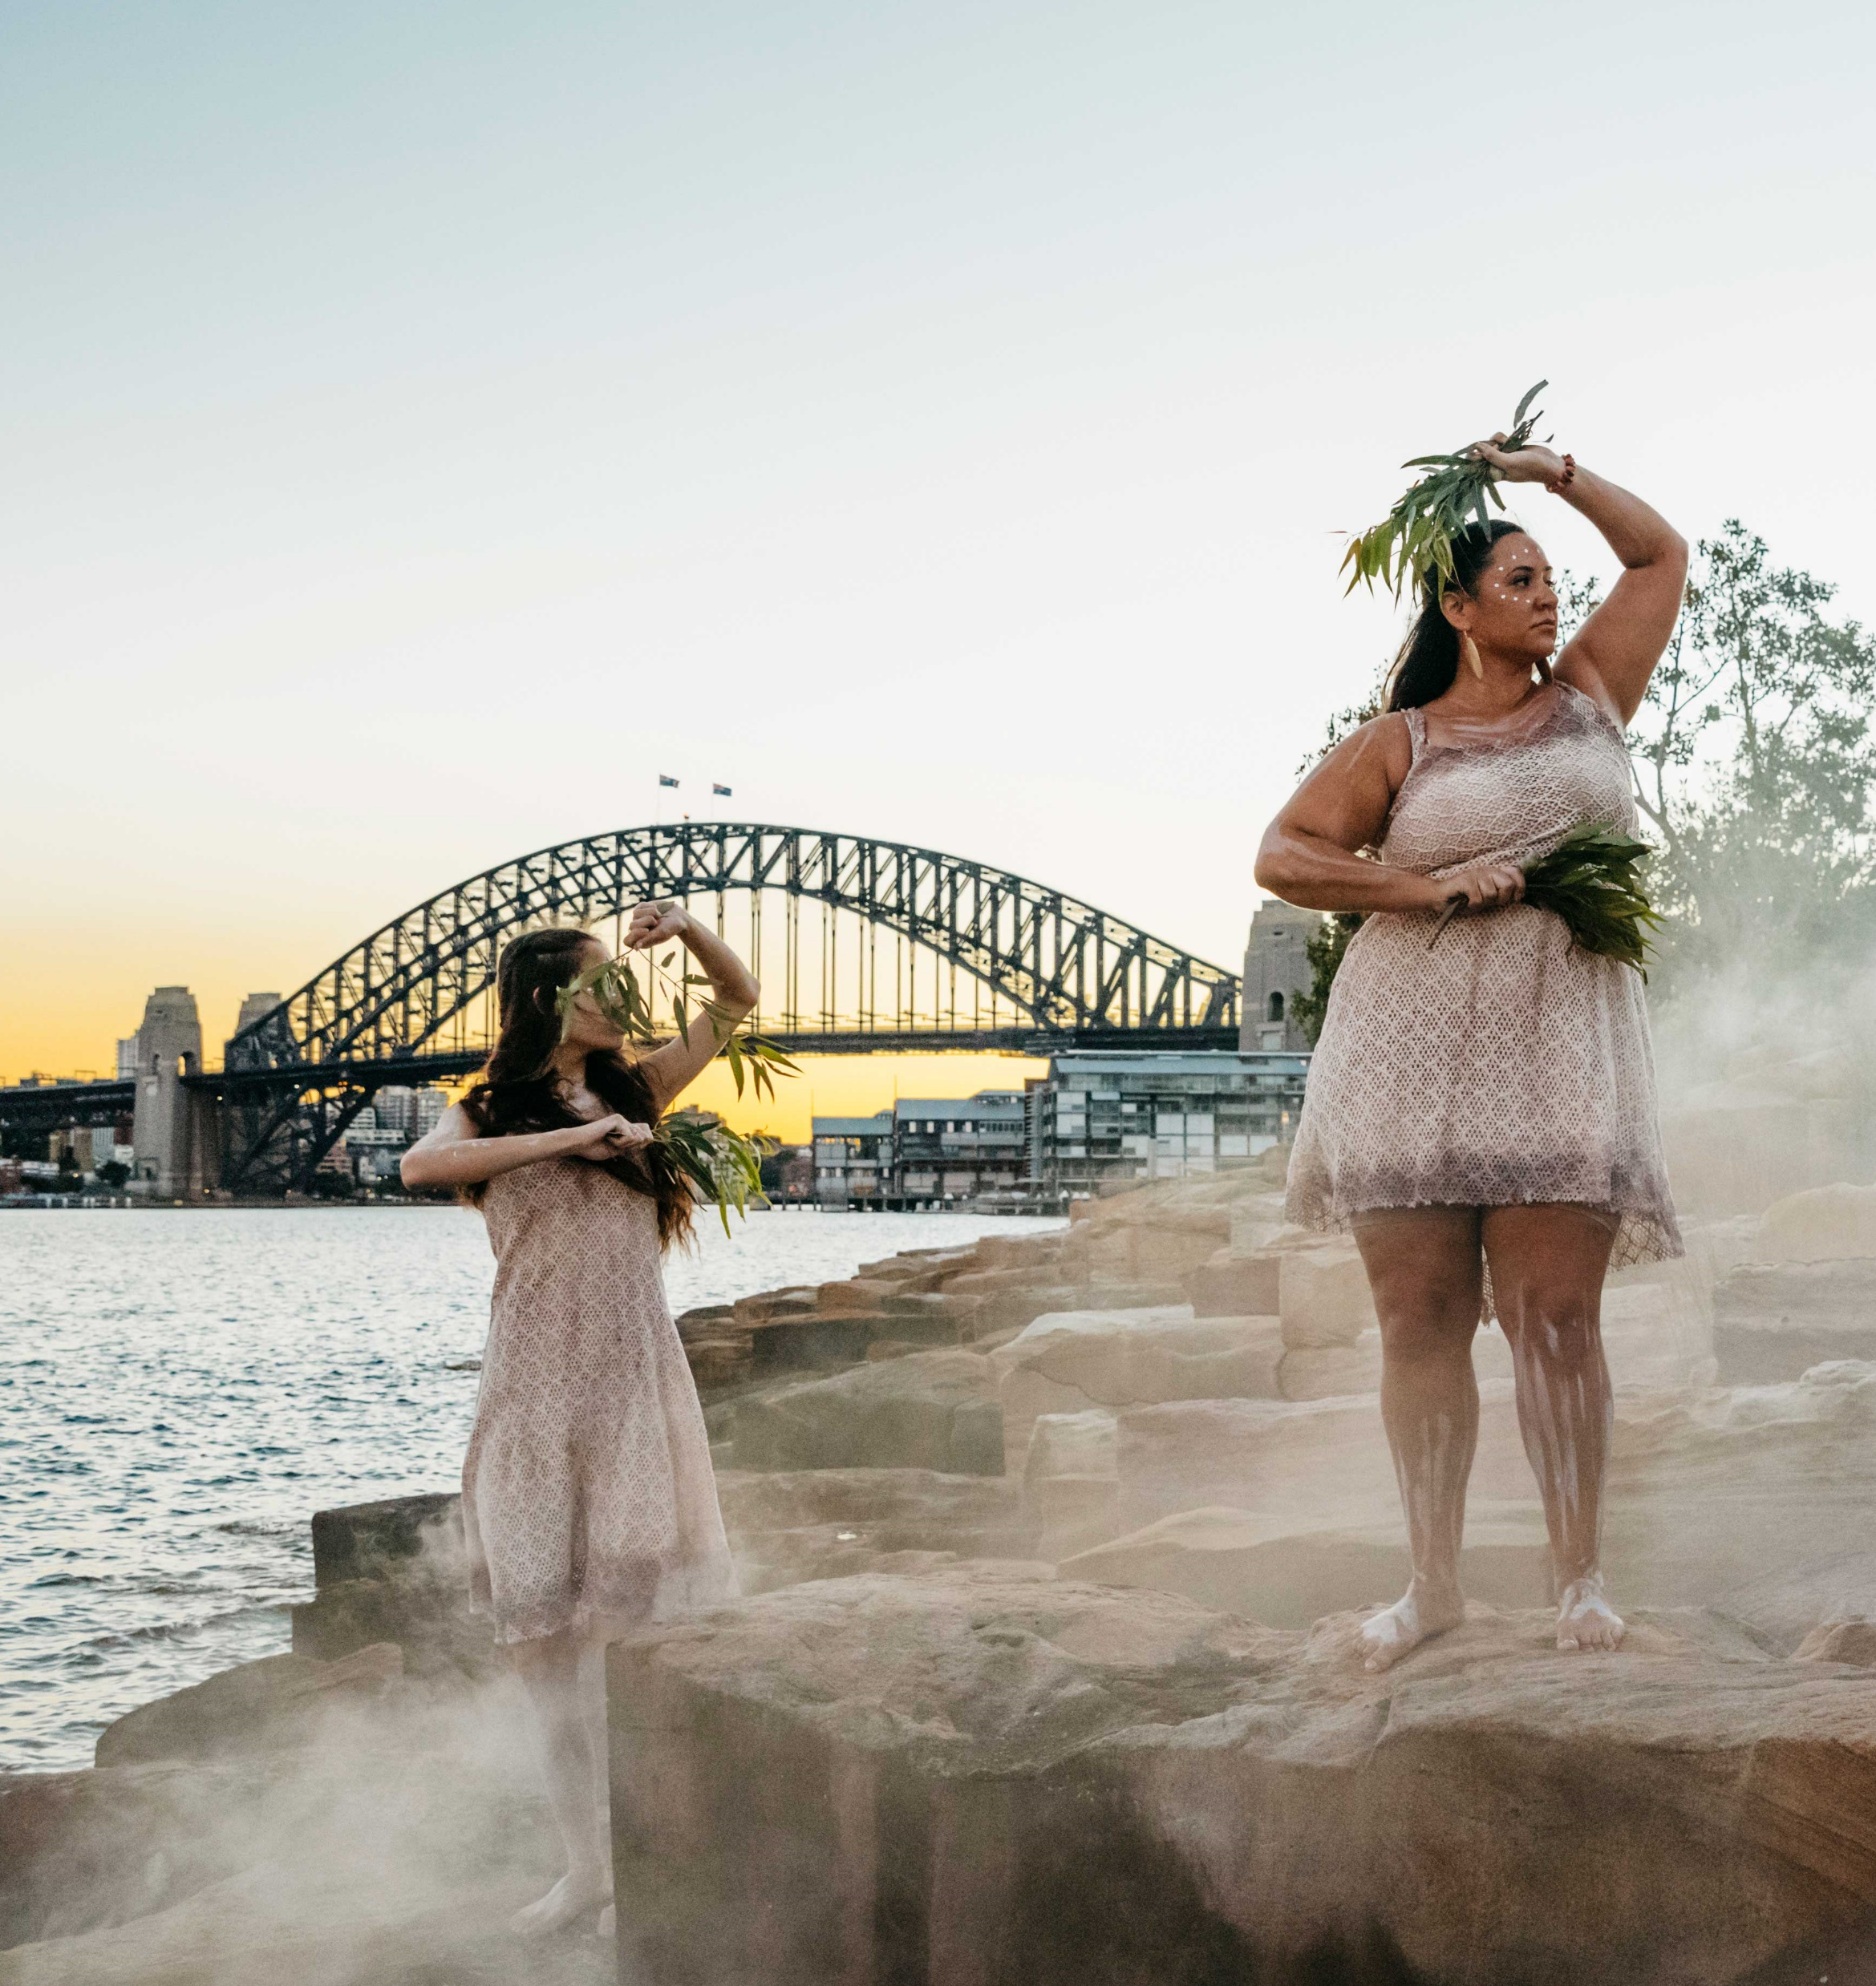
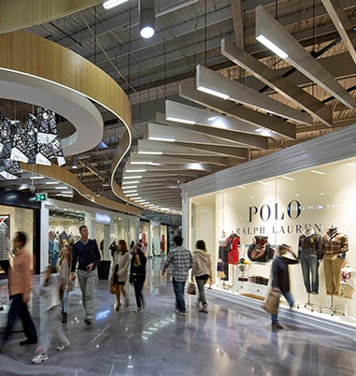
Iconic Sydney attractions
Sydney Opera House
Sydney Harbour Bridge
Wildlife Sydney Zoo
Bondi Beach
Sailing regatta on Sydney Harbour
The Royal Botanic Garden
Aboriginal Cultural Experience
Shopping

Slide 11
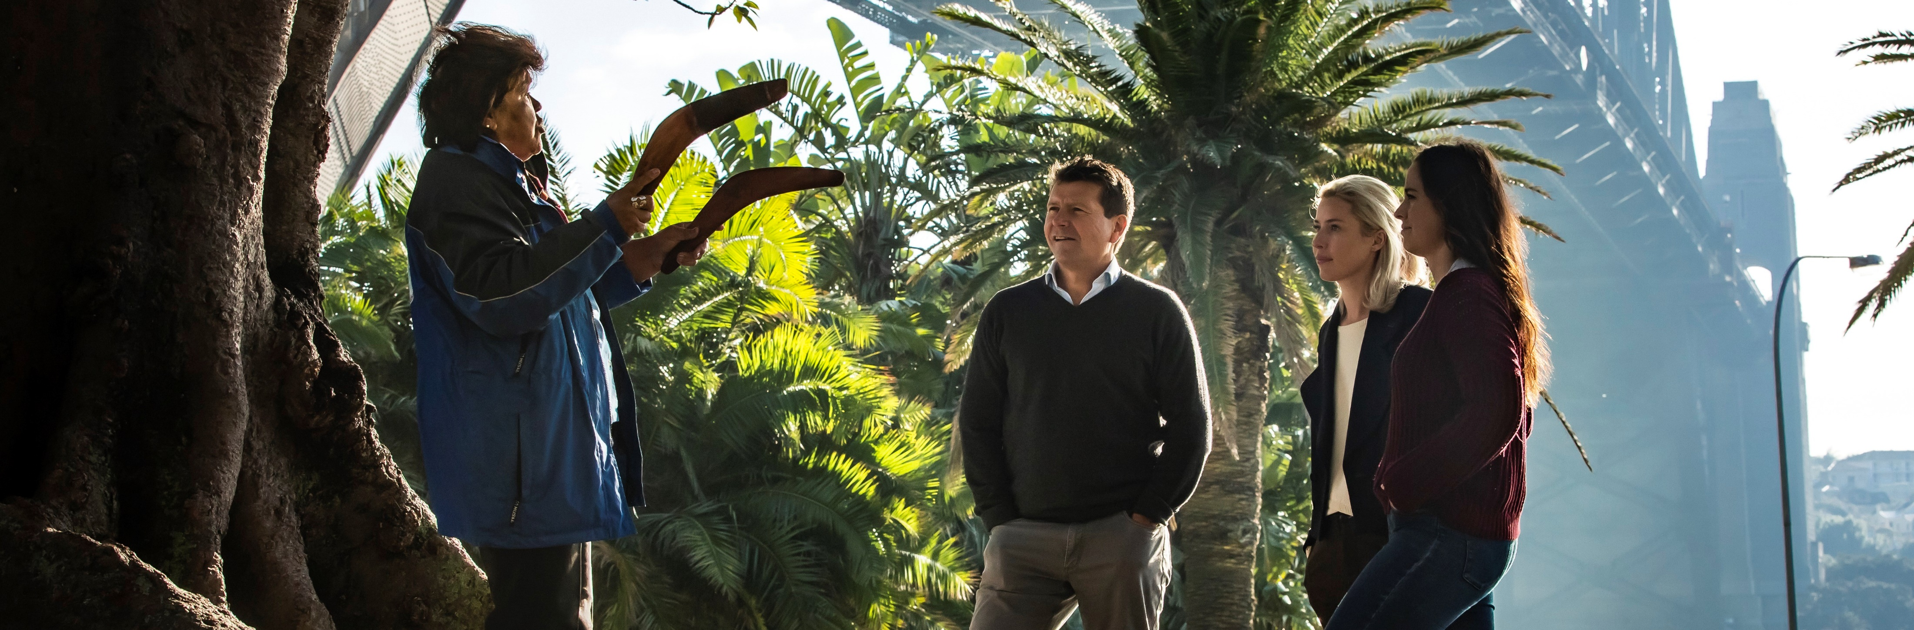
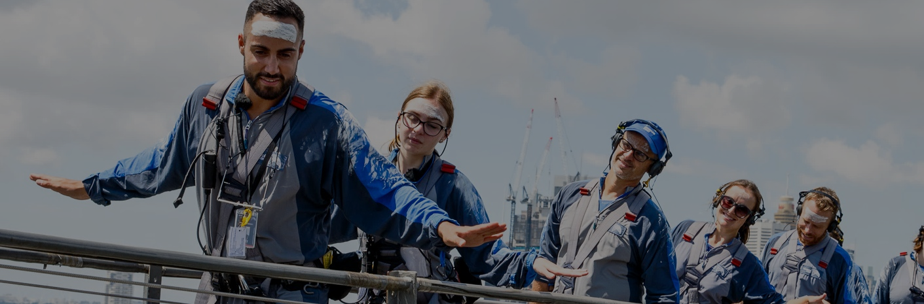
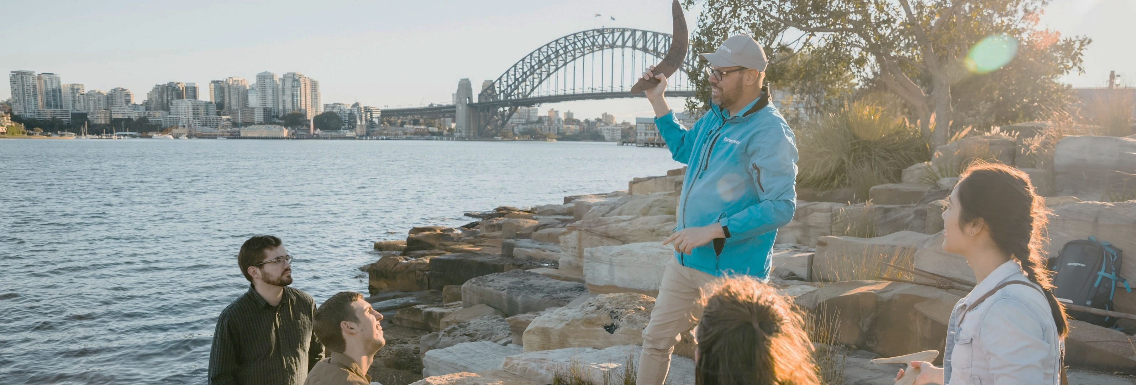
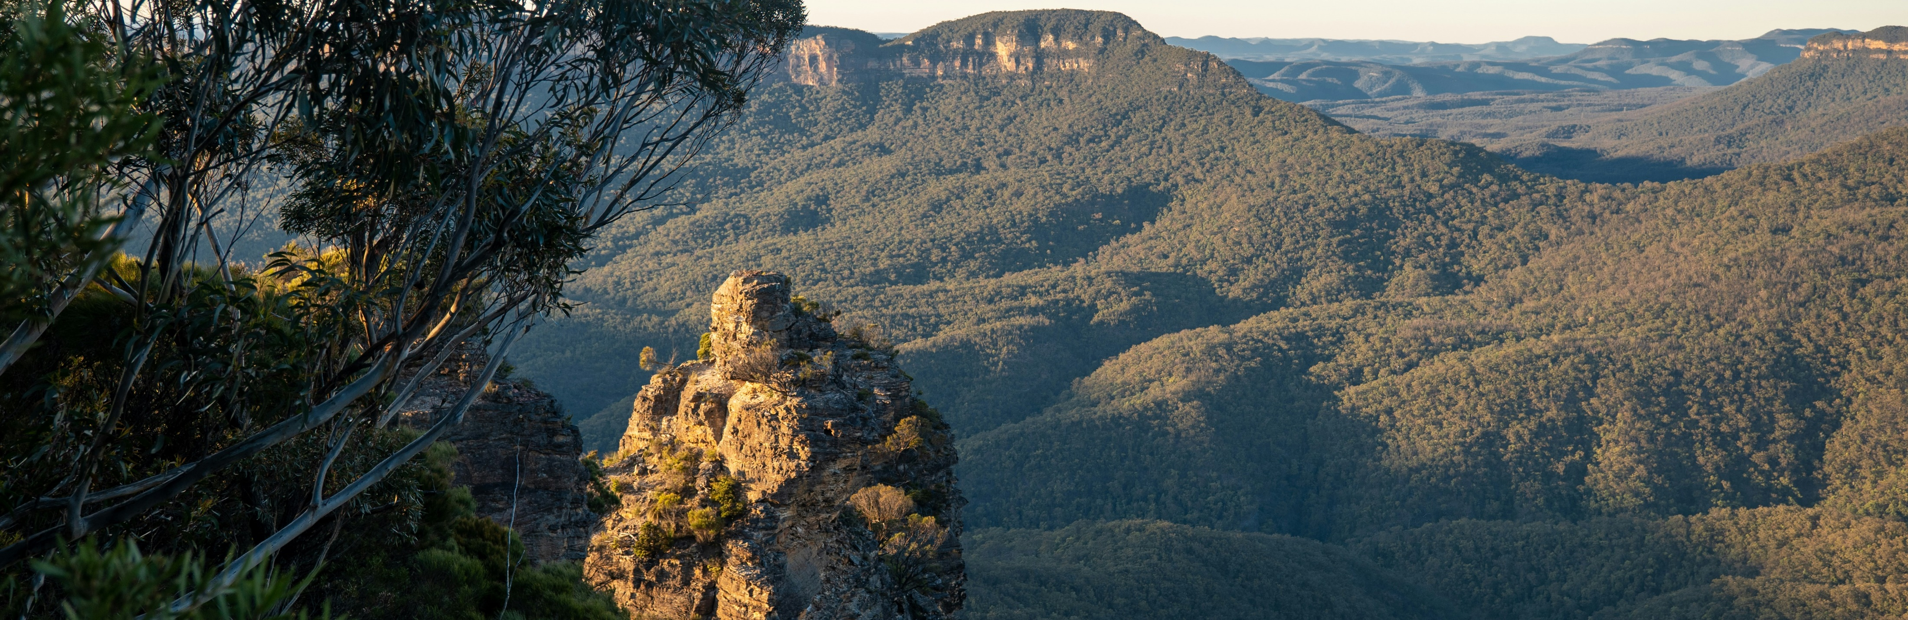
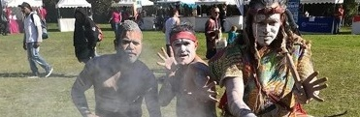
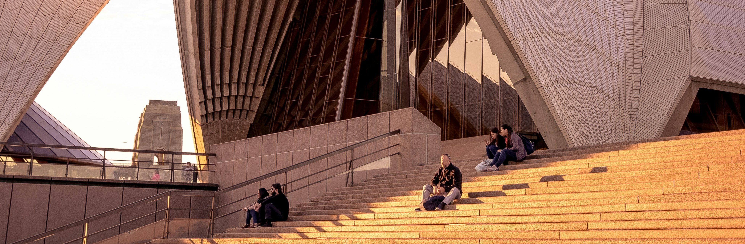
Cultural Experiences
The Rocks Aboriginal Dreaming tour
BridgeClimb – Burrawa Indigenous experience
Aboriginal Cultural Tour – Barangaroo Reserve
Blue Mountains Aboriginal Guided Tour
Giralang Guwal Aboriginal dance and cultural education
Sydney Opera House tour

Slide 12
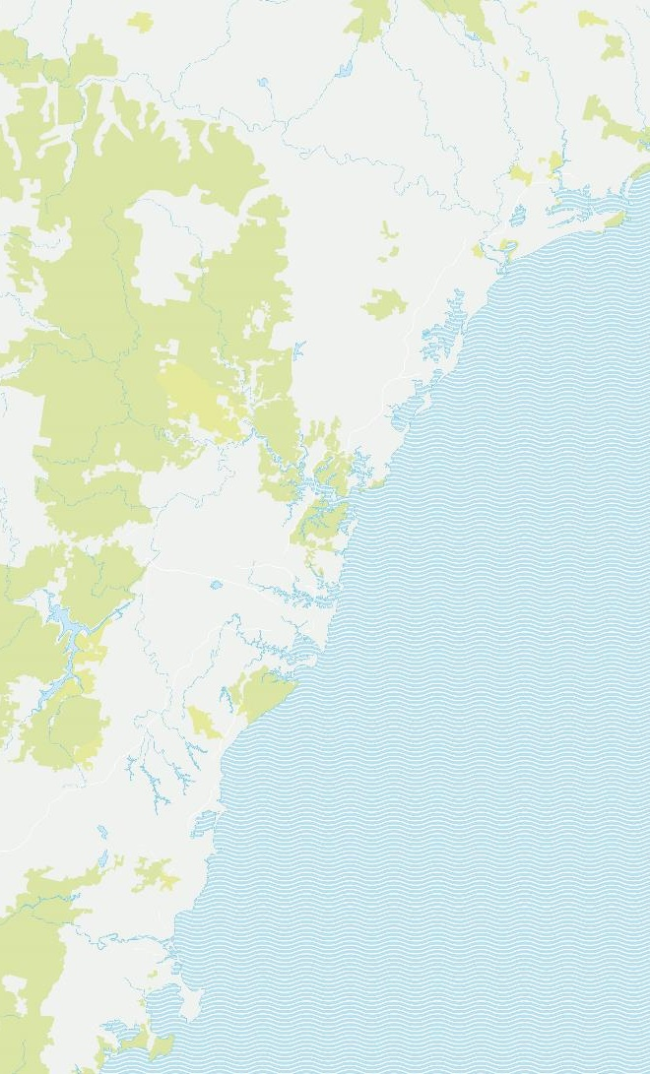
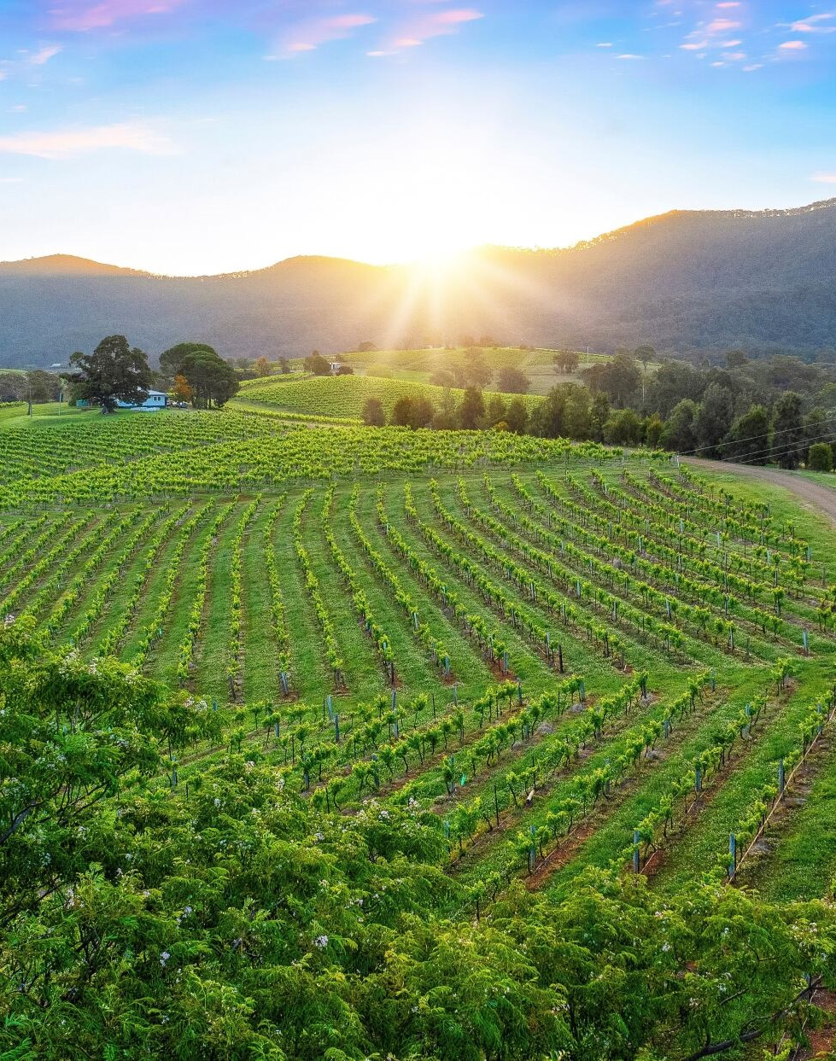
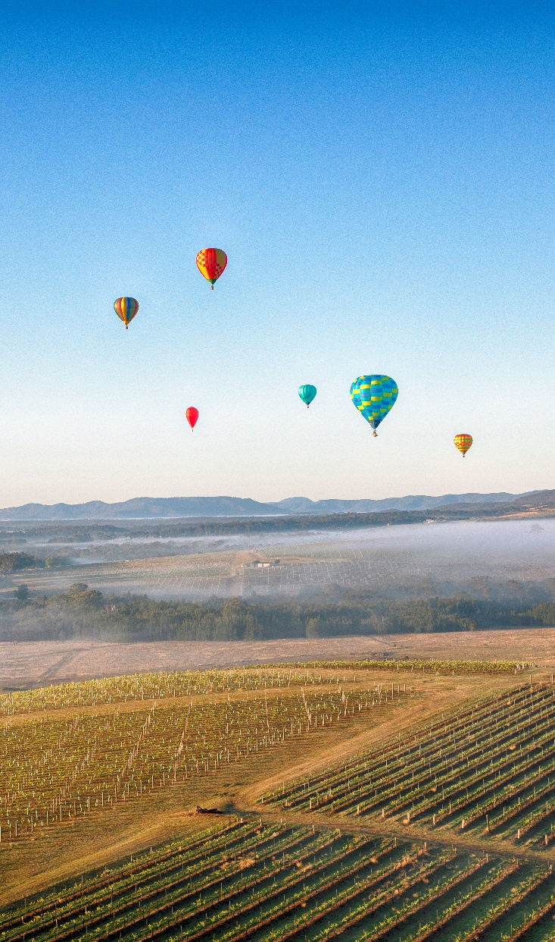
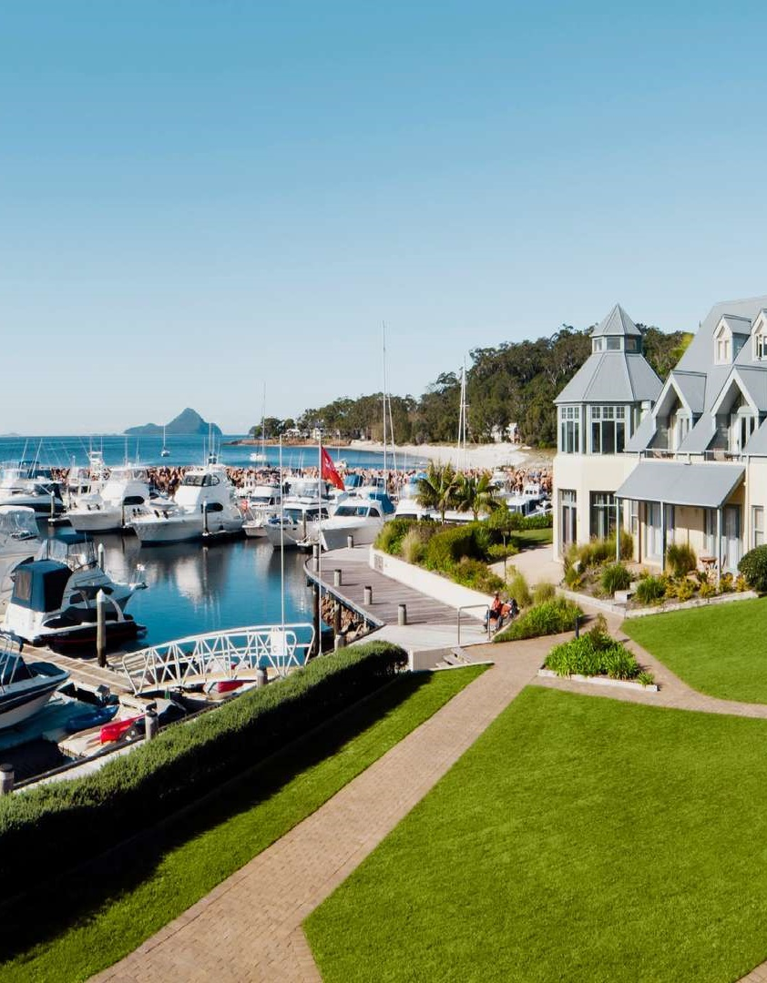
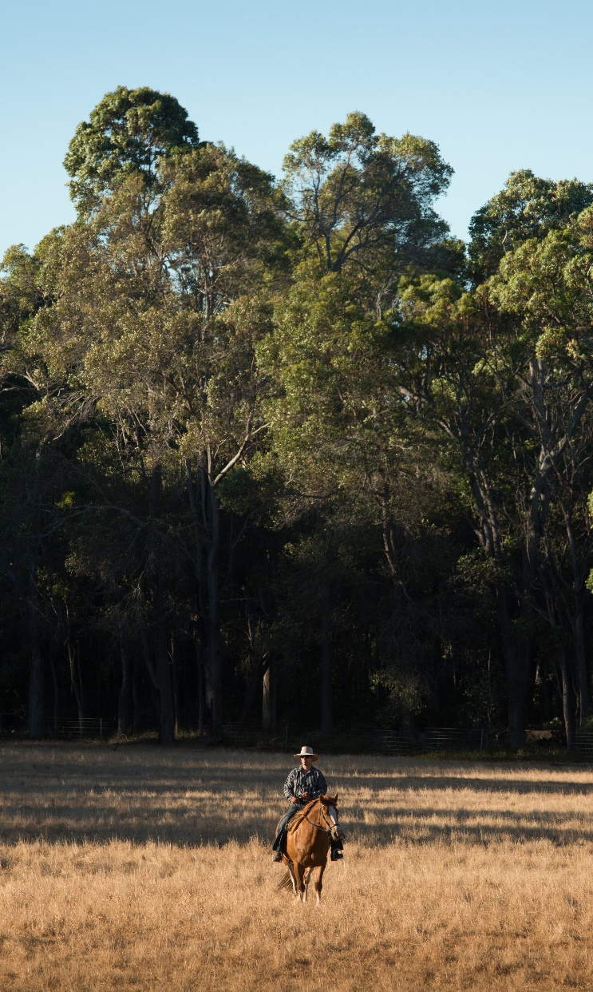
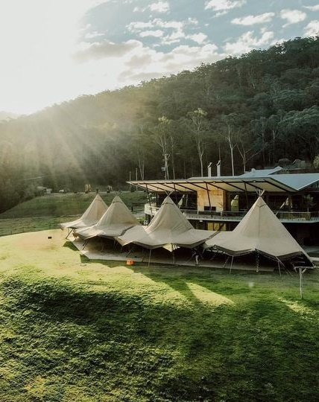
1
2
3
4
Sydney
1.
Hunter Valley
2.5hrs drive north
2.
Port Stephens
3hrs drive north
3.
Glenworth Valley
1h drive north
5
6
7
Notes:
Remove 4 Green block

Slide 13
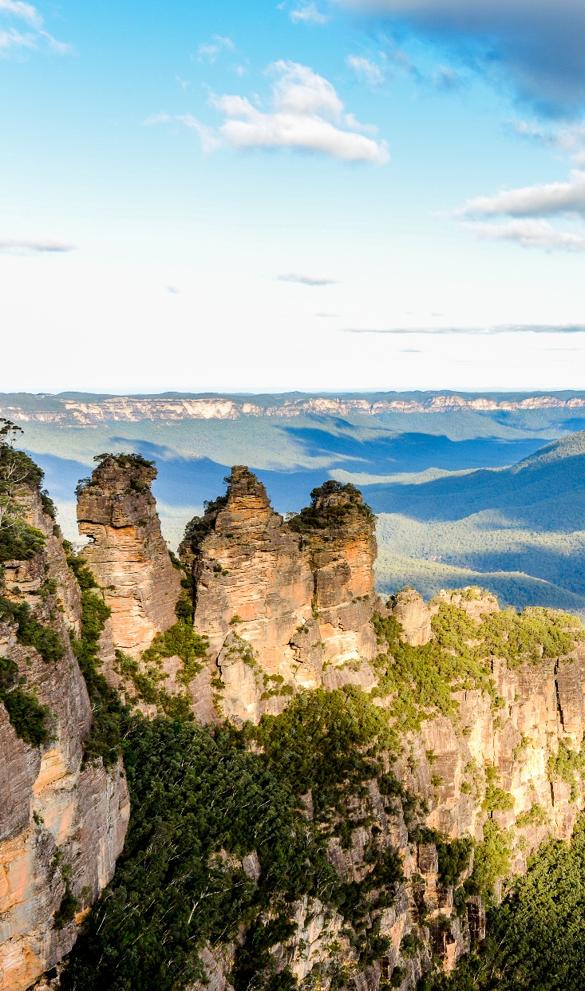
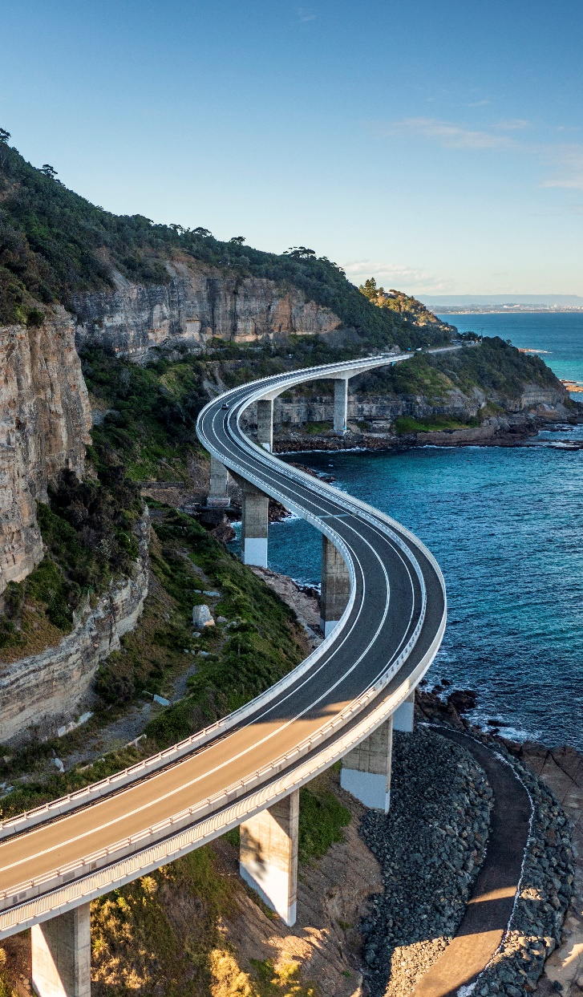
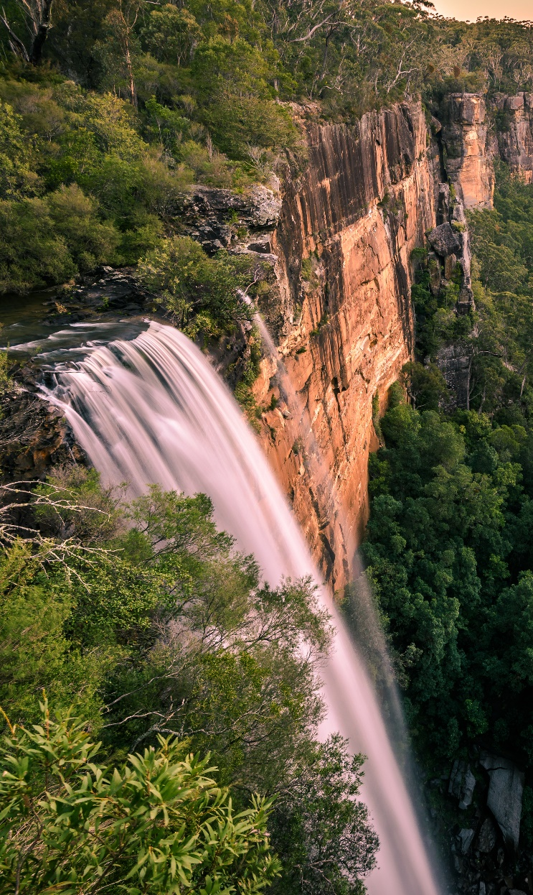
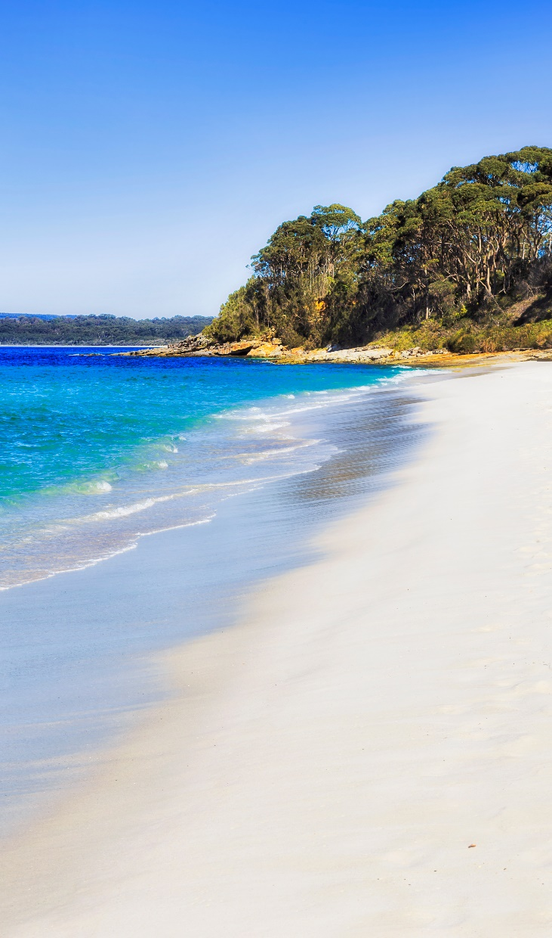
1
2
3
4
Sydney
4.
Blue Mountains
1.5hrs drive west
5.
Wollongong
1.5hrs drive south
6.
Southern Highlands
2hrs drive south
7.
Jervis Bay
2.5hrs drive south
5
6
7

Slide 14
Conference Venue
[venue name]
[details about venue]
[Potential additional points below – adjust as appropriate:]
[Located near/on Sydney’s sparkling harbour, in the heart of the city]
[Only 5 miles (20 minute drive) from Sydney Airport]
[Walk to iconic attractions]
[Surrounded by accommodation, restaurants and cafes to suit all budgets]
Notes:
Explore BESydney’s Supplier search on our website to find a suitable venue and other suppliers for your event: https://www.besydney.com.au/supplier-search/

Slide 15
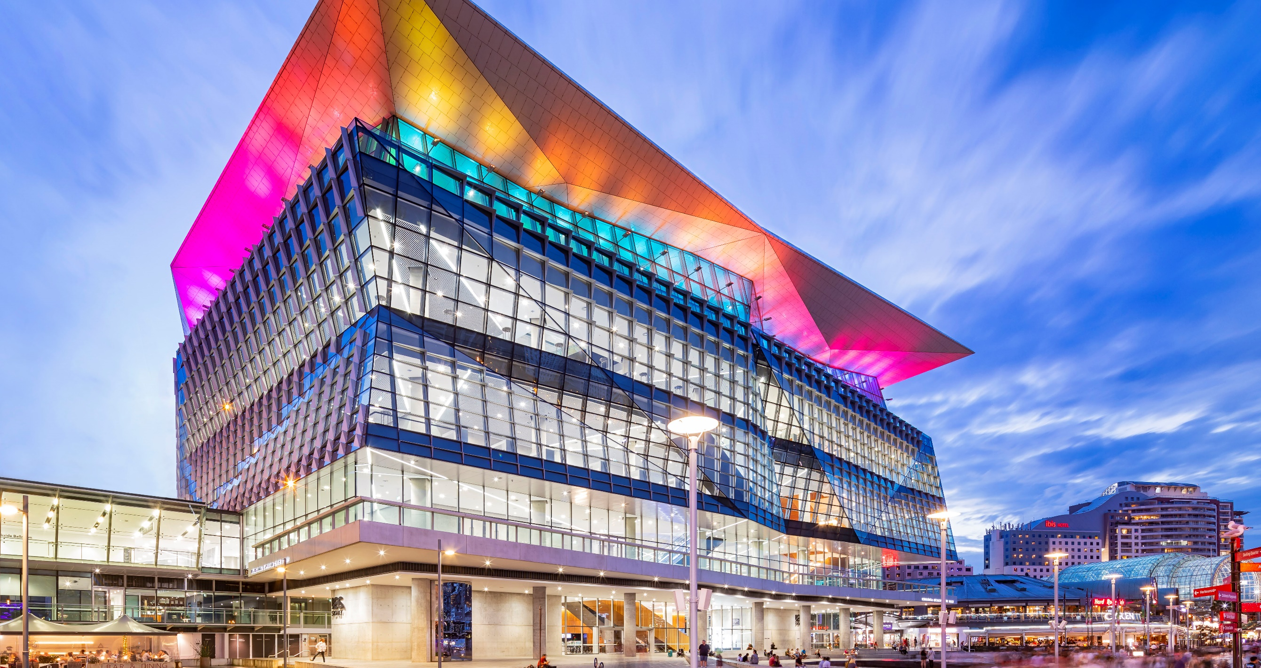


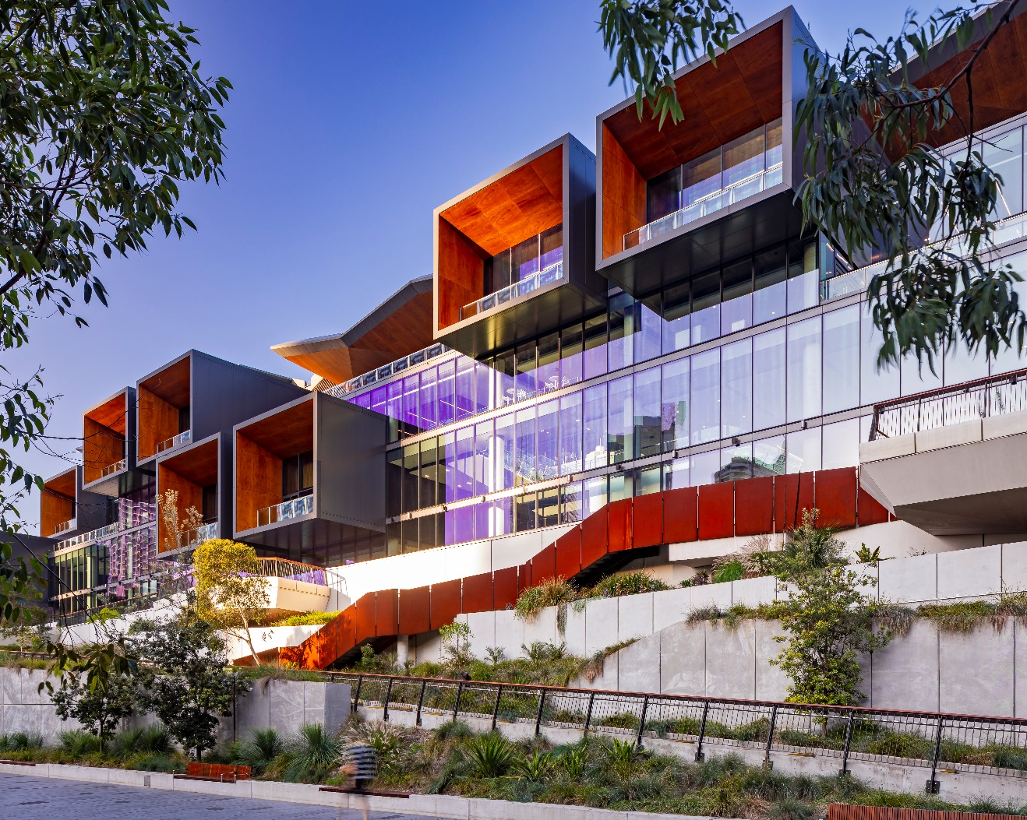
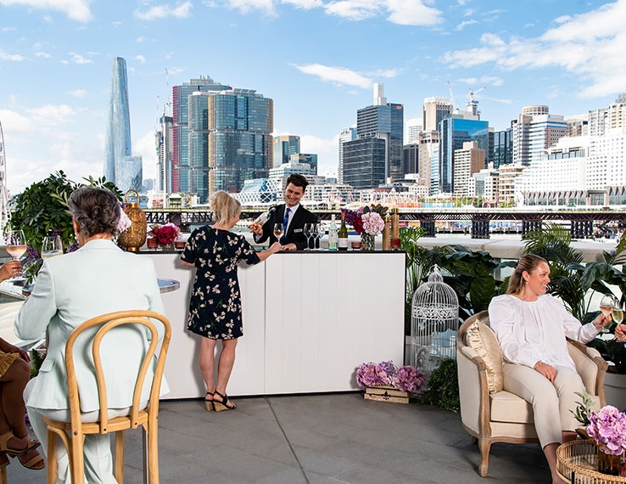


ICC Sydney
Capacity
Level 4 Exhibition Halls total up to 5000 pax (banquet setup)
The Theatre – 8000 pax (tiered)
Darling Harbour Theatre – 2500 pax (tiered)
Pyrmont Theatre – 1000 pax (tiered)
Function rooms
Total function rooms: 70
Largest room sqm: 8000
Find out more

Slide 16
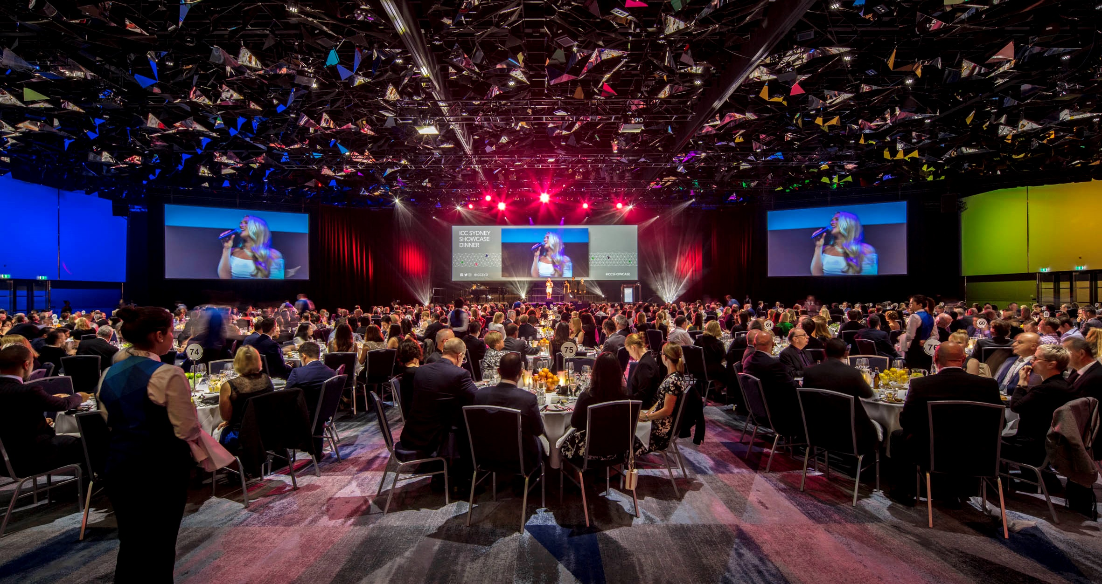
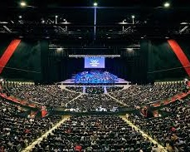
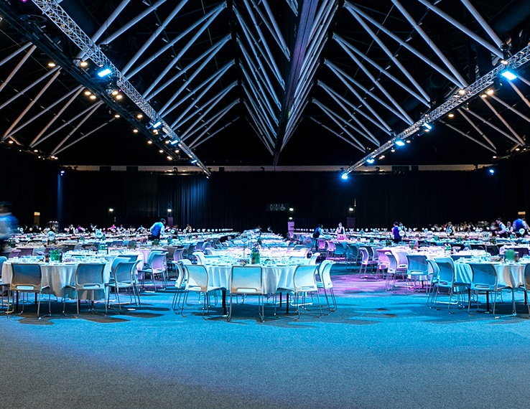
ICC Sydney
Capacity (banquet setup)
Grand Ballroom – 2000 pax
The Gallery – 1080 pax
Parkside Ballroom – 740pax
Function rooms
Total function rooms: 70
Largest room sqm: 8000
Find out more

